Slide 1
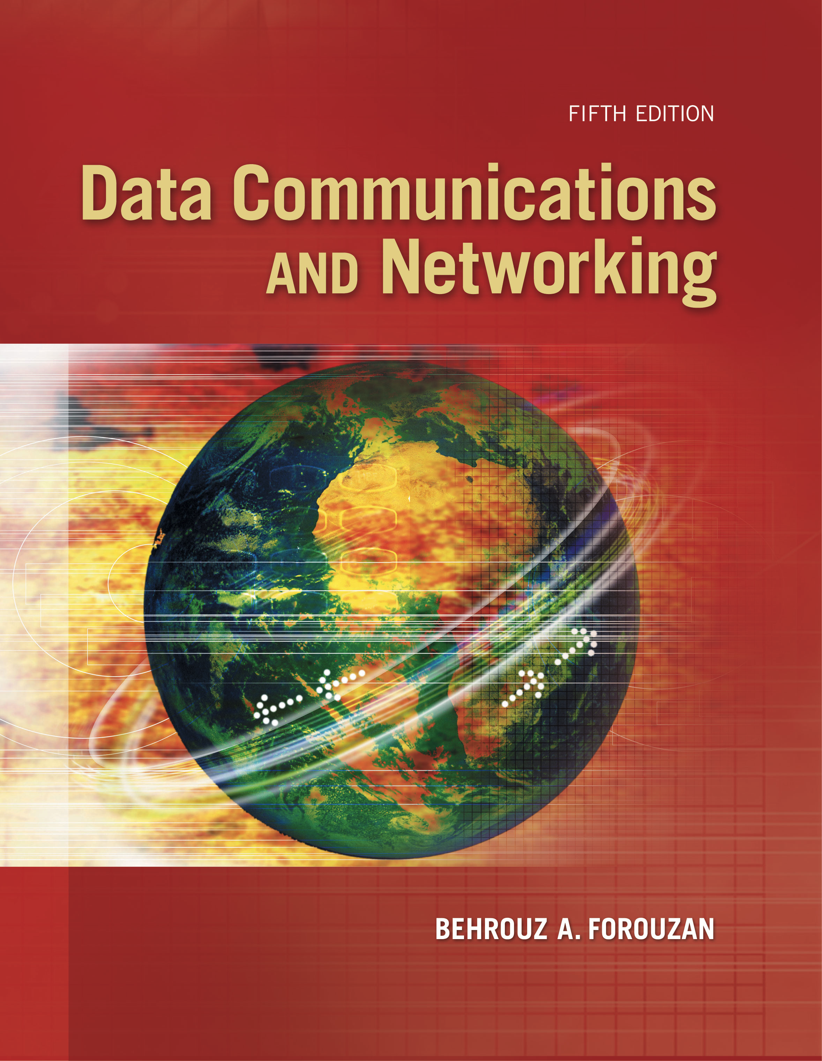
Computer Networks
Bluetooth Technology
S.V.Jansi Rani
Associate Professor / CSE

Slide 2
AGENDA
Bluetooth
Architecture
Bluetooth Layers
Single and Multiple Secondary Communication
Frame Format
Radio Layer

Slide 3



Slide 4
BLUETOOTH

Slide 5
BLUETOOTH
Bluetooth is a wireless LAN technology designed to connect devices of different functions when they are at a short distance from each other.
A Bluetooth LAN is an ad hoc network.
The devices, sometimes called gadgets, find each other and make a network called a piconet.
Bluetooth (IEEE 802.15) cannot be large

Slide 6
Architecture
Bluetooth defines two types of networks: piconet and scatternet.
Piconet - 8 stations
Parked state and active state
Device - 1 Mbps with a 2.4-GHz bandwidth

Slide 7
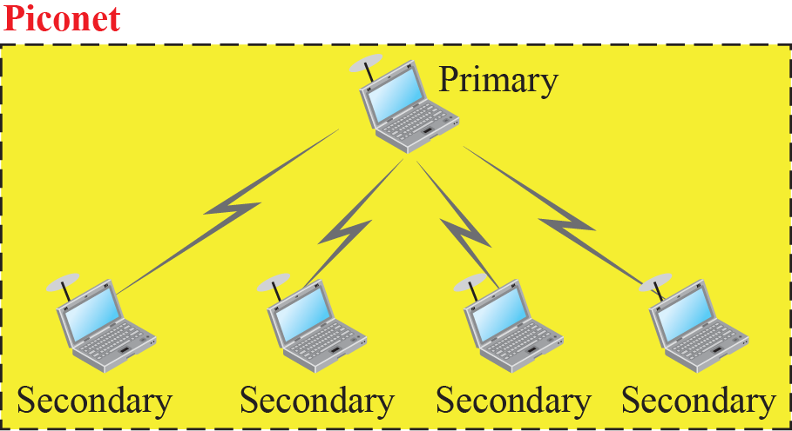
Piconet

Slide 8
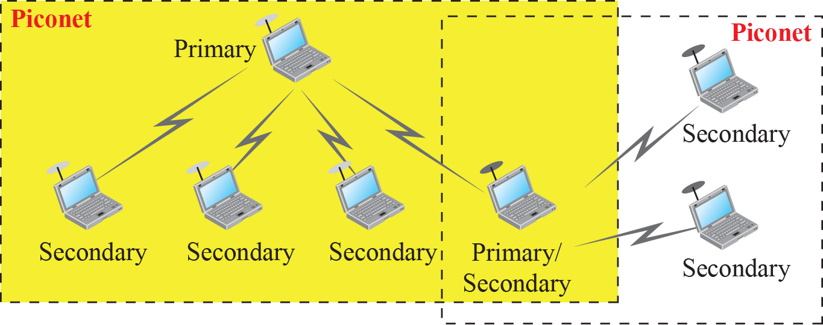
Scatternet

Slide 9
Bluetooth Layers
Bluetooth uses several layers that do not exactly match those of the Internet model

Slide 10
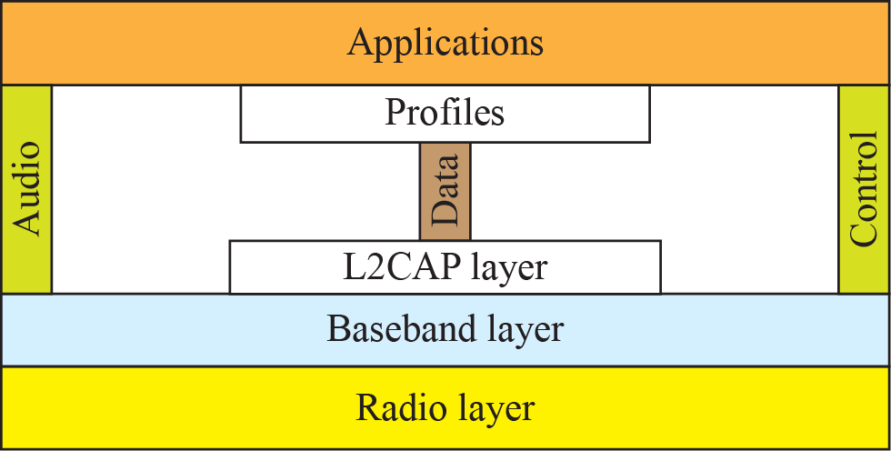
Bluetooth layers

Slide 11
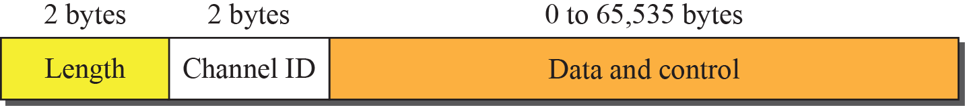
L2CAP data packet format

Slide 12
L2CAP
The L2CAP has specific duties: multiplexing, segmentation and reassembly, quality of service (QoS), and group management.
Multiplexing
Accepts data from UL -frames -delivers
Receiver site - accepts a frame from the baseband layer -extracts the data –delivers to appropriate protocol layer.

Slide 13
L2CAP
Segmentation and Reassembly
Maximum size of the payload field in the baseband layer is 2774 bits, or 343 bytes.
Size of the packet - 339 bytes (excluding 4 bytes header
Need to send a data packet that can be up to 65,535 bytes
L2CAP divides these large packets into segments
L2CAP segments the packets at the source and reassembles them at the destination.

Slide 14
L2CAP
QOS
Best effort service
Group Management
Another functionality -allow devices to create a type of logical addressing between themselves.
This is similar to multicasting.
For example, two or three secondary devices can be part of a multicast group to receive data from the primary.

Slide 15
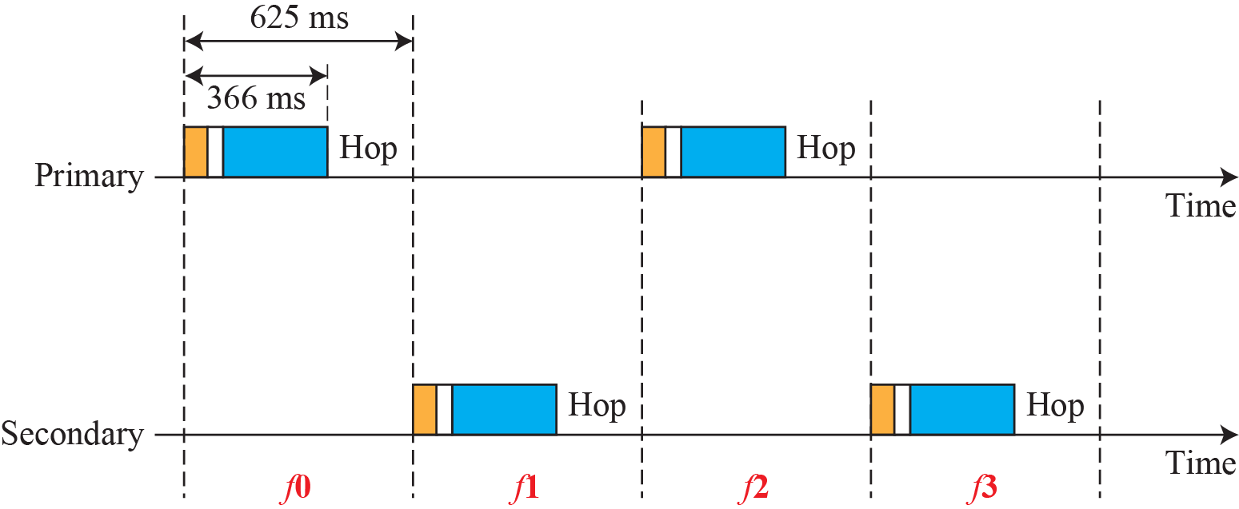
Single-secondary communication

Slide 16
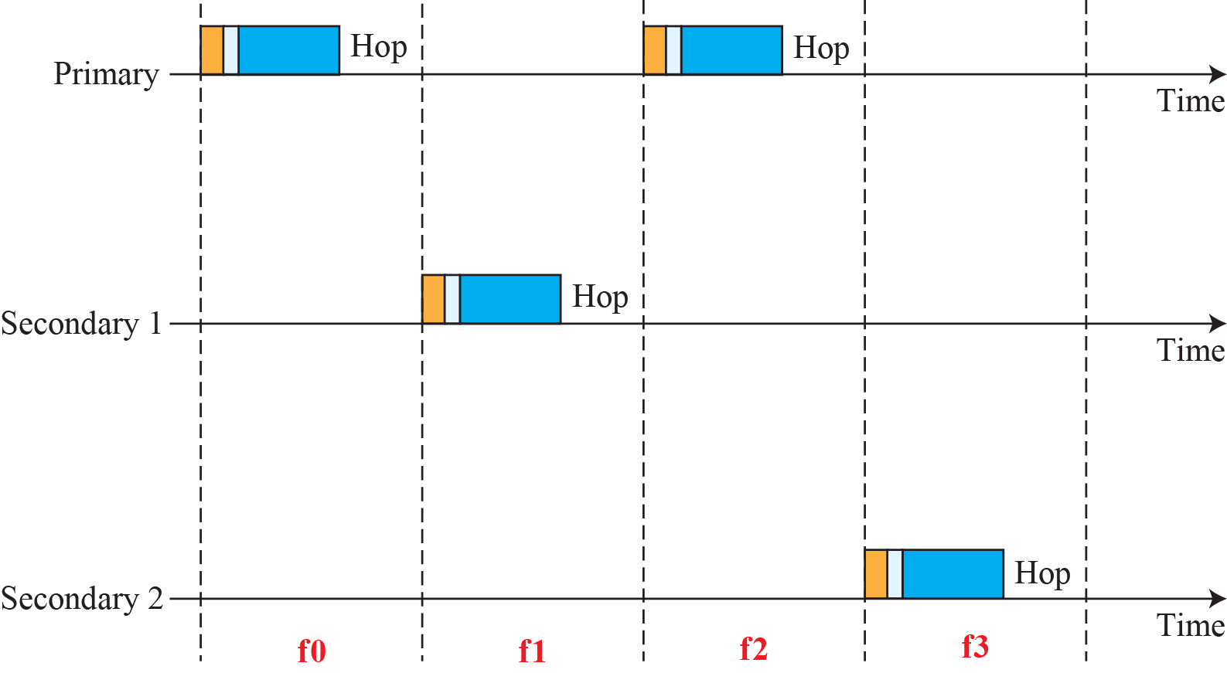
Multiple-secondary communication

Slide 17
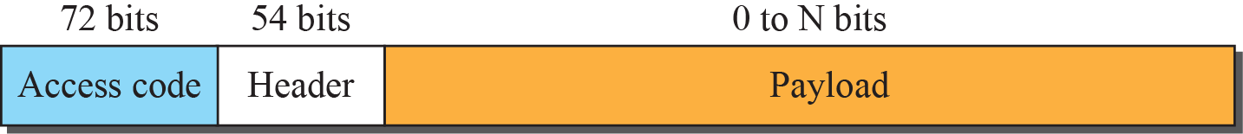
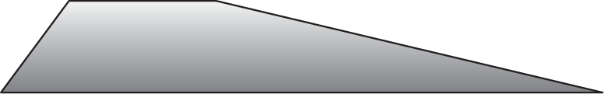
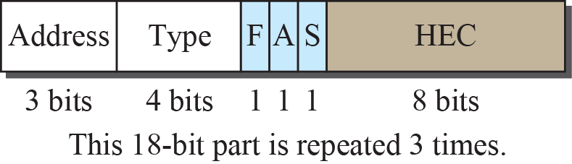
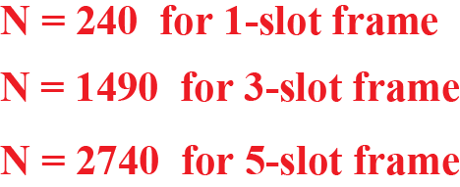
Frame format types

Slide 18
Radio Layer
The radio layer is roughly equivalent to the physical layer of the Internet model.
Bluetooth devices are low-power and have a range of 10 m.
Band
Bluetooth uses a 2.4-GHz ISM band divided into 79 channels of 1 MHz each.
FHSS
Bluetooth hops 1600 times per second, which means that each device changes its modulation frequency 1600 times per second.
A device uses a frequency for only 625 μs (1/1600 s) before it hops to another frequency; the dwell time is 625 μs.

Slide 19
Radio Layer
Modulation
Bluetooth uses a sophisticated version of FSK, called
GFSK (FSK with Gaussian bandwidth filtering).
GFSK has a carrier frequency. Bit 1 is represented by a frequency deviation above the carrier; bit 0 is represented by a frequency deviation below the carrier.
The frequencies, in megahertz, are defined according to the following formula for each channel.
F_{c} = 2402 + n MHz , n = 0,1,2 3….,78
For example, the first channel uses carrier frequency 2402 MHz (2.402 GHz)
second channel uses carrier frequency 2403 MHz (2.403 GHz).

Slide 20
Check Your Understanding
What is the basic unit of bluetooth
Which flow control protocol is used in Bluetooth?

Slide 21
Outcome
Student should be able to
Explain the Bluetooth technology

Slide 22
THANK YOU

